Slide 1
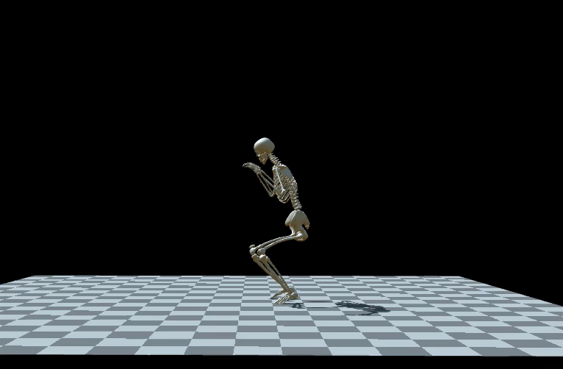
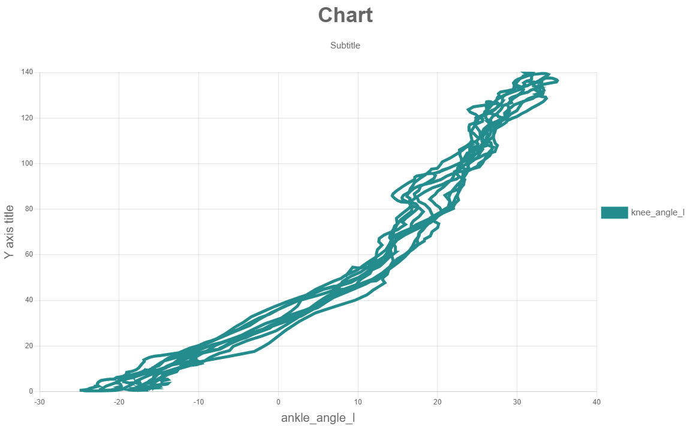
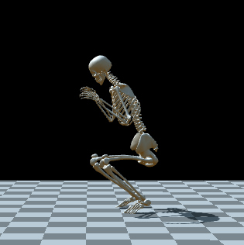
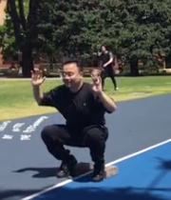
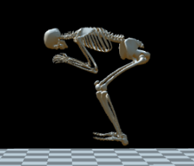
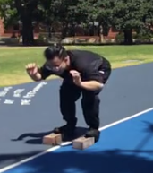
AIM: How to do a perfect squat
OPENSIM:
Video of OpenSim model, including GRF vector; make sure the video is looped so it continues playing throughout your presentation
experiment
RESULTS:
CONCLUSION: knee_angle is significantly positively correlated with ankle_angle, On the premise of safety. Placing a brick on the heel is the most effective squat position
Notes:
INSTRUCTIONS:
You may use this template when constructing your slide for the presentations in Week 8. Replace italic text with your own content.
You are welcome to change this slide stylistically, but make sure you have all the elements included in the template.
You are permitted have up to 3-slides so you can split these elements over different slides if you want to.
Practice presenting your slides you should talk for between 2-minutes and 2.5-minutes.
We have lots of presentations so we need you on time!
Marks will be lost for presenting for more than 2.5-minutes.

